Slide 1
BUILDER PATTERN
Şenol Yazar

Slide 2
Definition
Used to ease the construction of complex object from simple object
Seperate the construction of complex object from its represantation so that the same constuction process can create different representations

Slide 3
Applicability
Use Builder Pattern when:
Algorithm for creating complex object should be independent of the parts that make up the object and how they are assembled
The construction process must allow different representation for the object that is constructed
The building process can be broken down into discrete steps (difference between Builder and Abstract Factory)
You want to insulate the clients from the knowledge of the actual creation process and / or resulting product

Slide 4
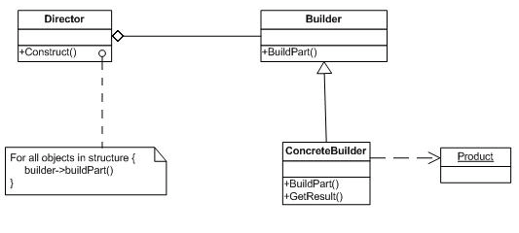
Structure

Slide 5
Participants
Builder
specifies an abstract interface for creating parts of a product object
ConcreteBuilder
Implements the Builder Interface
Defines and keeps track of the representation it creates
Provides an interface for retrieving the product
Director
constructs an object using the Builder interface
Product
represents the complex object under construction

Slide 6
Collaborations
The client creates the Director object and configures it with the desired builder object
Director notifies the builder whenever a part of the product should be built
Builder handles requests from the director and adds parts to the product
The client retrieves the product from the builder

Slide 7
Implementation
Typically there's an abstract Builder class that defines an operation for each component that a director may ask it to create. The operations do nothing by default. A ConcreteBuilder class overrides operations for components it's interested in creating
Let’s see it on Java

Slide 8
Benefits
Encapsulates the way a complex object is constructed
Allows objects to be constructed in a multistep and varying process
Hides the internal representation of the product from the client
Product implementations can be swapped in and out because the client only sees an abstract interface

Slide 9
Uses and Drawbacks
Often used for building composite structures
Constructing objects requires more domain knowledge of the client than when using Factory

Slide 10
Known Uses
The RTF converter application is from ET++ [WGM88]. Its text building block uses a builder to process text stored in the RTF format
Builder is a common pattern in Smalltalk-80 [Par90]

Slide 11
References
http://en.wikipedia.org/wiki/Builder_pattern
http://www.javadesign.info/DesignConcepts/DesignPatterns/GOF/builder_pattern
http://www.dofactory.com/Patterns/PatternBuilder.aspx
http://www.avajava.com/tutorials/lessons/builder-pattern.html
Head First Design Patterns
http://oreilly.com/catalog/9780596007126

